Slide 1
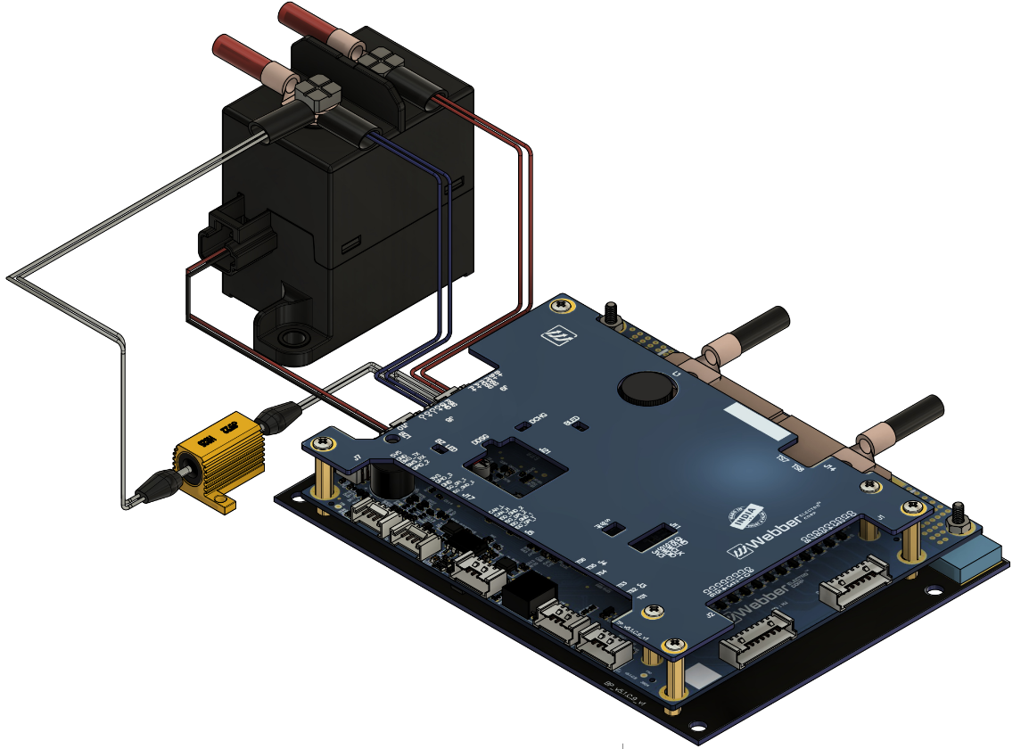
WBMS-SW-16S Contactor
Smart BMS Manages Lithium Ion Batteries
with Precision and Speed
Specification Sheet v3.0

Slide 2
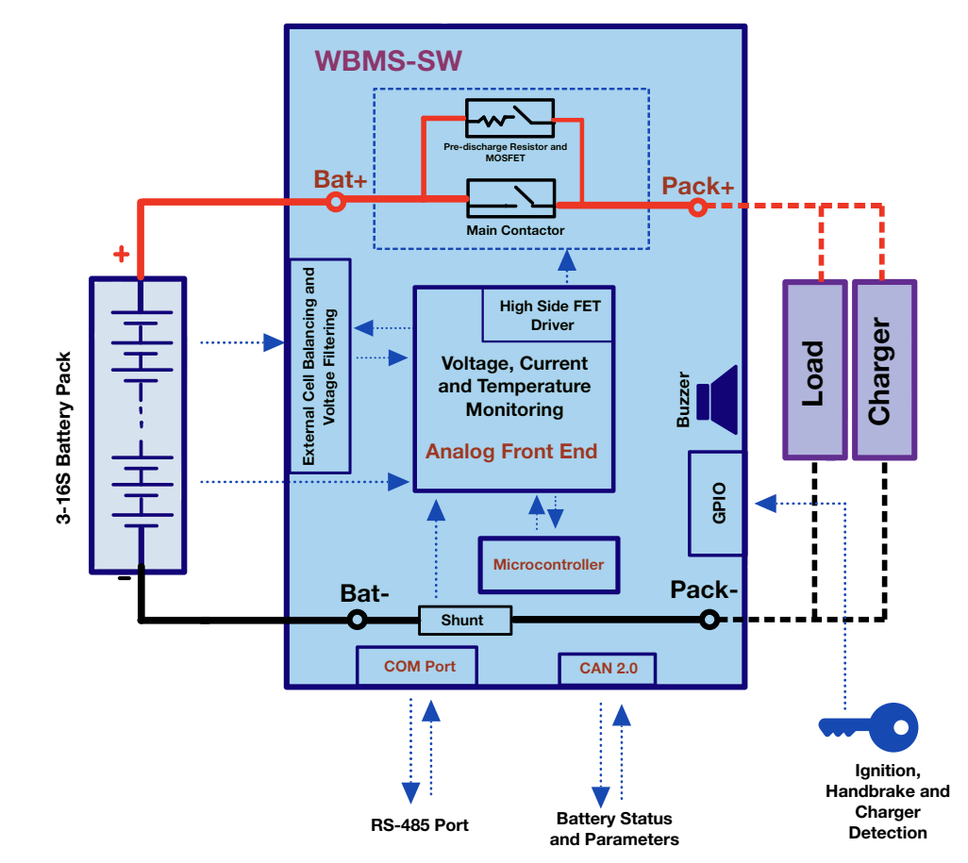
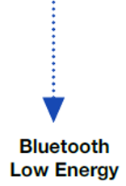


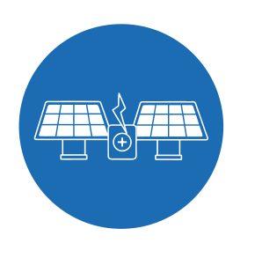

Application Diagram
Application Diagram
ISO CAN2.0B

Slide 3
Salient Features
Scalable up to 16 cells & 48-60V battery packs
AIS-156 PH-II Compliant
Buzzer output and LED Indication for Thermal Runaway, Open Wire Fault and MOSFET Failure
Multiple communication options: Isolated CAN2.0 and BLE
Onboard: uSD Card and EEPROM
High side Contactor Switching provides safe and uninterrupted ground connection to external subsystems.
Hardware and Software interlocks for Charger and Discharge Paths
On board power supply and switching or predischarge control. Does not need external 12V power supply and predisharge contactor
Predischarge control for preventing inrush currents to capacitive loads
Short Circuit and Overcurrent in discharge latches ensure automatic locking of discharge path after repeated short circuit and overcurrent faults
High cell balancing current up to 400mA minimizes cell to cell voltage and SOC variations and optimal charging of battery pack
Individual Cell over and under voltage and temperature protection
Pack level over current and short circuit protection
Deep Discharge Prevention (Auto BMS Shutdown) when cell voltage is critically low
Proprietary CAN based field servicing tools for data monitoring, logging and firmware update

Slide 4
Specifications |  |  | Remarks
Number of Cells |  | Min: 3 Max: 16
Cell Voltage Sensing Range |  | 1.6 - 4.5V
Peak Battery Terminal Voltage |  | 68 V (16S)
Sensing Accuracy |  | Cell Voltage: ±3mV Current: ±1%
Dimension |  | 165 mm X 102 mm X 28 mm (L X B X H)
Nominal Current Rating | Charging and Discharging Current | Up to 250A
Cell Balancing | Balancing Current per Cell | Up to ~400mA
Pre-discharge control | Nominal Capacitive load | 3-6mF in 0.5 seconds (Customisable)
BMS Self Current Consumption | Active Mode, Shutdown Mode | Active Mode: ~50mA (Contactor OFF) ~100mA (Contactor ON) Shutdown Mode: ~8uA
Temperature Sensing | Onboard | One channel for onboard MOSFET temperature
 | External | Six external channels for cell temperature
 | Range and Accuracy | Range: -10℃ to 120℃ Accuracy ±1℃,
Onboard Data Storage | uSD Card or EEPROM | uSD Card: every 1 second, logged over last 60 days
Over Voltage Protection | Threshold, Protection Trigger Delay | Configurable | Configurable, based on target fully charged voltage
 | Fault Response | Contactor: OFF. Discharging is allowed if Charger is removed and Ignition is ON
 | Fault Release | Through Hysteresis, Automatic
Under Voltage Protection | Threshold, Protection Trigger Delay | Configurable | Configurable, based on target fully charged voltage
 | Fault Response | Contactor: OFF Charging is allowed if Charger is connected and Ignition is OFF
 | Fault Release | Configurable Hysteresis | No load removal required. Charging current is allowed.
Over Current in Discharge Protection Level-1 | Threshold, Protection Trigger Delay | Configurable to allow up to 300A discharge for up to 60 seconds | Configurable
 | Fault Response | Contactor: OFF Charging and Discharging are allowed only after fault is cleared
 | Fault Release | Auto recovery after no discharge current for 90 secs
Over Current in Discharge Protection Level-2 | Threshold, Protection Trigger Delay | Configurable to instantaneously cut off at 400A discharge current in 100 mSec
 | Fault Response | Contactor: OFF Charging and Discharging are allowed only after fault is cleared
 | Fault Release | Auto recovery after no discharge current for 90 secs
Note: Specifications are indicative only. Final specifications and behaviour including continuous discharge/charge current, balancing current, protection thresholds, etc. may vary depending upon BMS version, BMS mounting scheme, PDU heat dissipation, programmed parameters and application logic.

Slide 5
Specifications |  |  | Remarks
Over Current in Discharge Latch Protection | Threshold | 5 consecutive over discharge current faults
 | Fault Response | Contactor: OFF Charging and Discharging are allowed only after fault is cleared
 | Fault Release | Load Removal
Over Current in Charge Protection Level-1 | Threshold, Protection Trigger Delay | Configurable to allow up to 200A charge current for up to 60 seconds | Configurable
 | Fault Response | Contactor: OFF Discharging is allowed if Charger is removed and Ignition is ON
 | Fault Release | Auto recovery after no charge current for 90 secs
Over Current in Charge Protection Level-2 | Threshold, Protection Trigger Delay | Configurable to instantaneously cut off at 250A charge current in 100 mSec
 | Fault Response | Contactor: OFF Discharging is allowed if Charger is removed and Ignition is ON
 | Fault Release | Auto recovery after no charge current for 90 secs
Short Circuit in Discharge Protection | Protection Trigger Delay | ～20 mSec
 | Fault Response | Contactor: OFF
 | Fault Release | Auto recovery after 5 seconds
Short Circuit in Discharge Latch Protection | Threshold | 2 consecutive short circuit faults
 | Fault Response | Contactor: OFF
 | Fault Release | Load Removal
Over Temperature in Discharge Protection | Threshold, Protection Trigger Delay | Configurable | Configurable
 | Fault Response | Contactor: OFF Charging is allowed if Charger is connected and Ignition is OFF
 | Fault Release | Auto recovery below configurable temperature
Under Temperature in Discharge Protection | Threshold, Protection Trigger Delay | Configurable | Configurable
 | Fault Response | Contactor: OFF Charging is allowed if Charger is connected and Ignition is OFF
 | Fault Release | Auto recovery above configurable temperature
Over Temperature in Charge Protection | Threshold, Protection Trigger Delay | Configurable | Configurable
 | Fault Response | Contactor: OFF Discharging is allowed if Charger is removed and Ignition is ON
 | Fault Release | Auto recovery below configurable temperature
Under Temperature in Charge Protection | Threshold, Protection Trigger Delay | Configurable | Configurable
 | Fault Response | Contactor: OFF Discharging is allowed if Charger is removed and Ignition is ON
 | Fault Release | Auto recovery above configurable temperature
Buzzer Output | Alert on Permanent Failure | Thermal Runaway, Contactor Failure, Cell Open Wire, Short Circuit Latch, Over Current in Discharge Latch, Insulation Failure

Slide 6
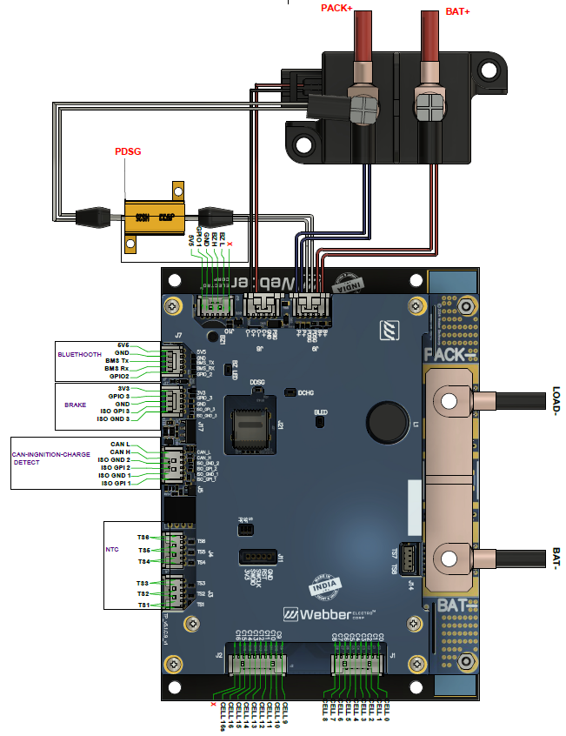
Pin Diagram

Slide 7
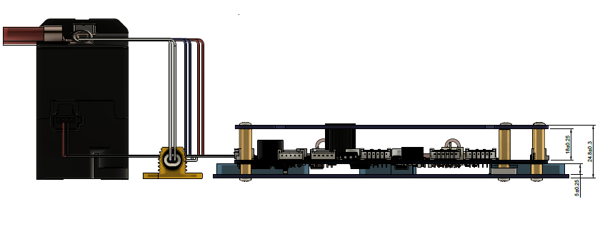
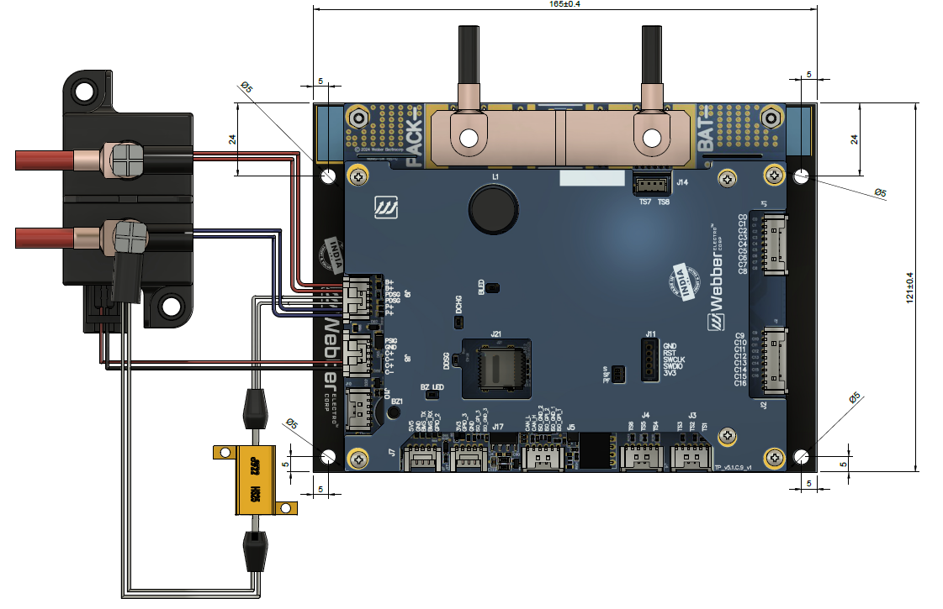
Mechanical Dimensions
All dimensions in mm

